Slide 1
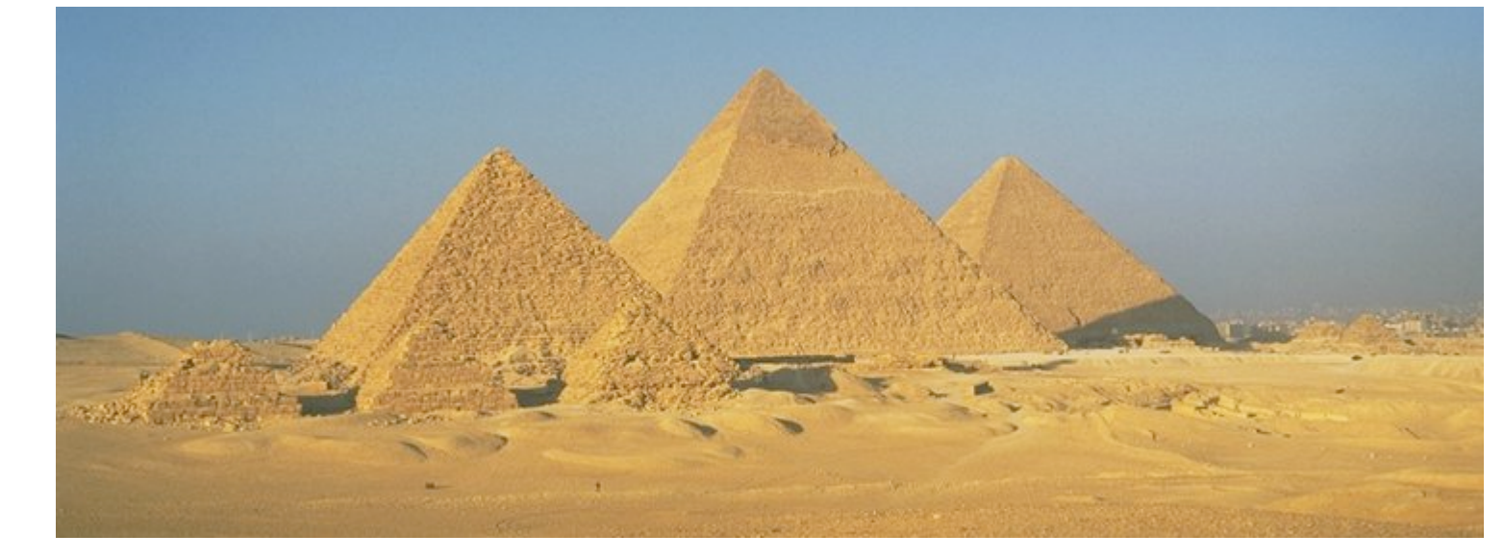
CSC589 Introduction to Computer Vision Lecture 11 Gaussian Pyramids

Slide 2
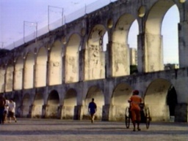
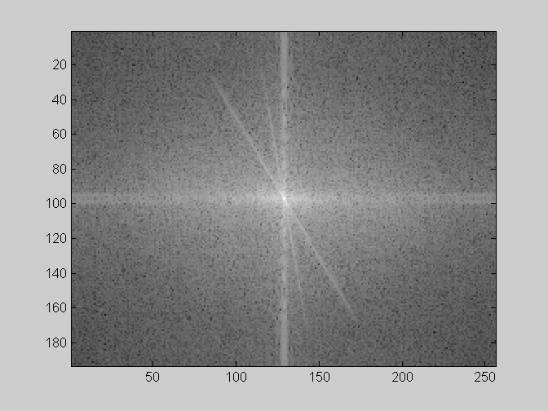
Man-made Scene

Slide 3
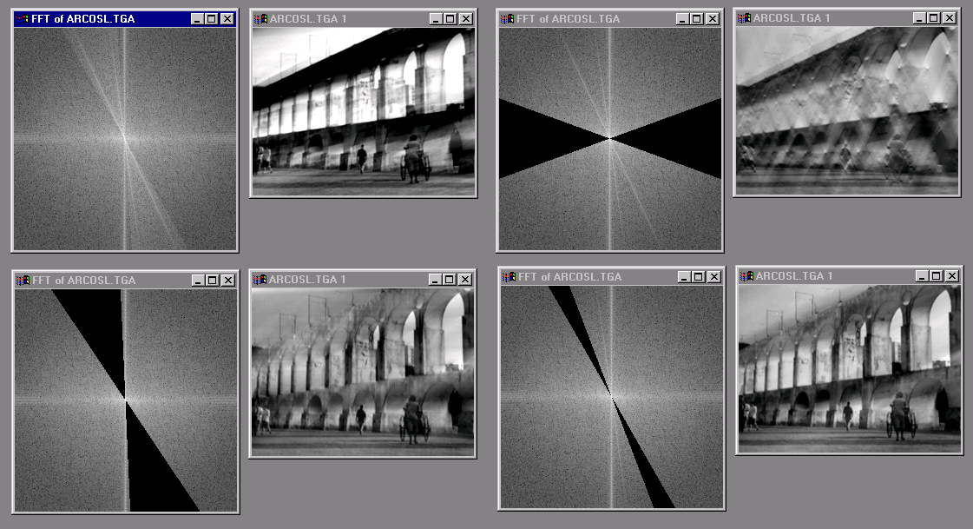
Can change spectrum, then reconstruct

Slide 4
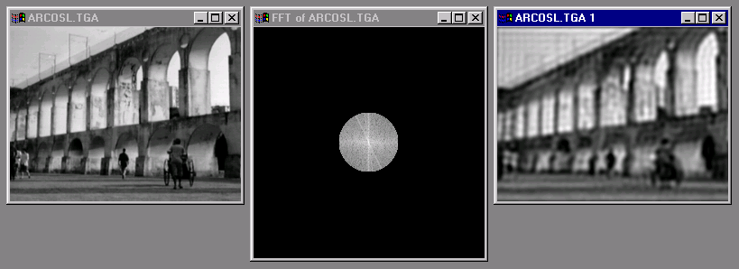
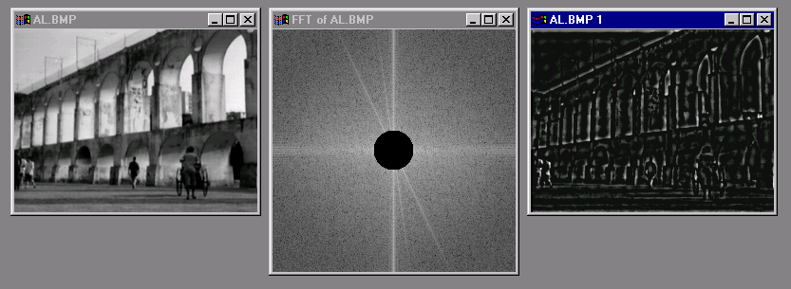
Low and High Pass filtering

Slide 5
Today’s class
Image Pyramids
Take-home reading: Chapter 3.5 Pyramids and Wavelents (Szeliski)
Original Burt&Adelson 93
http://persci.mit.edu/pub_pdfs/pyramid83.pdf

Slide 6
Image representation
Pixels: great for spatial resolution, poor access to frequency
Fourier transform: great for frequency, not for spatial info
Pyramids/filter banks: balance between spatial and frequency information

Slide 7
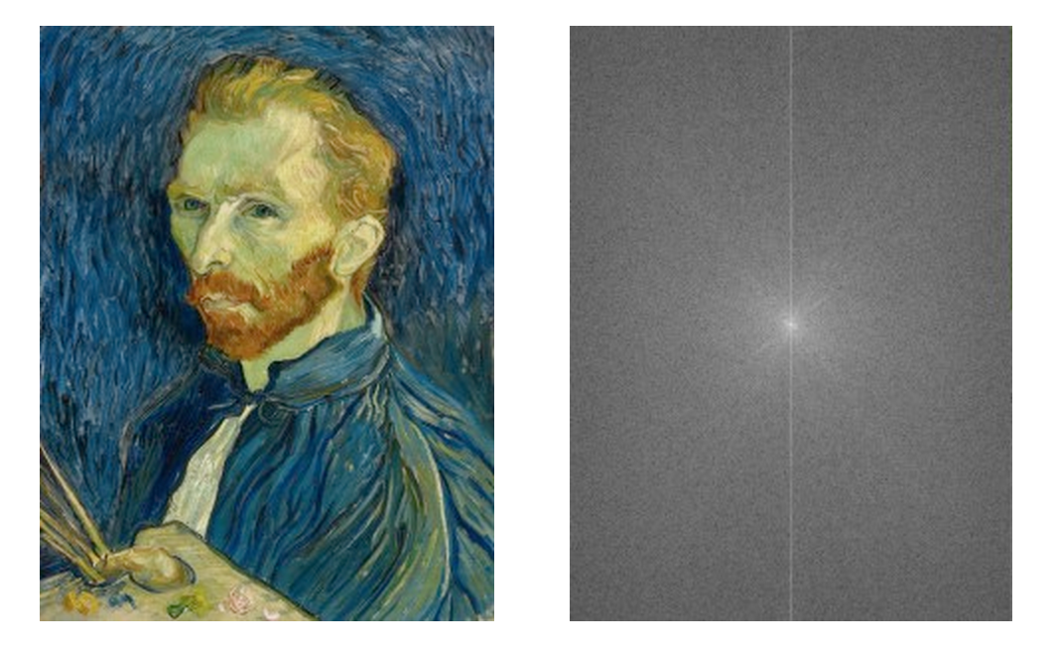
Fourier vs. Spatial Representation

Slide 8
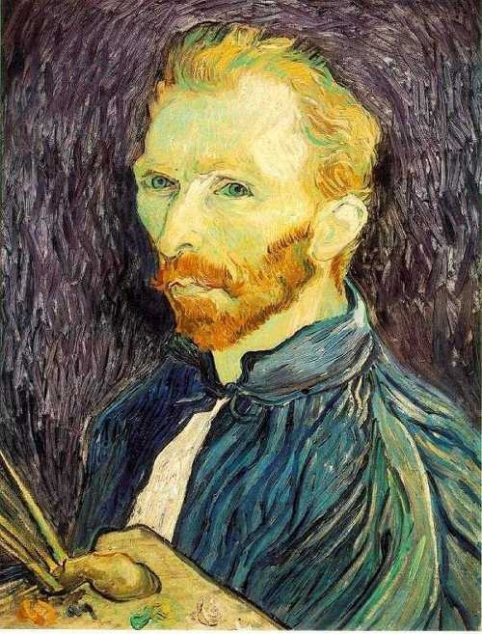
Image Scaling
This image is too big to fit on the screen. How can we generate a half-sized version?
Source: S. Seitz

Slide 9

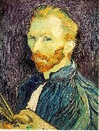

Image sub-sampling
1/8
1/4
Throw away every other row and column to create a 1/2 size image
- called image sub-sampling
Source: S. Seitz

Slide 10
Image sub-sampling
1/2
1/4 (2x zoom)
1/8 (4x zoom)
Why does this look so crufty?
Source: S. Seitz

Slide 11
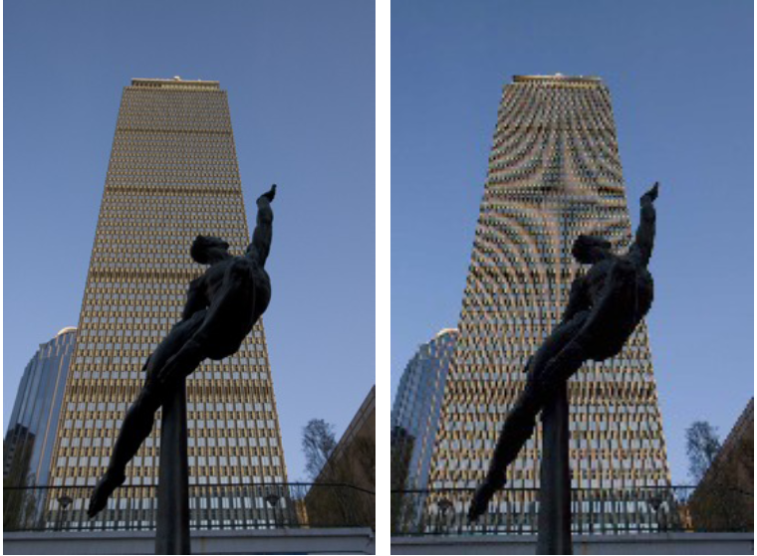
Image sub-sampling
Source: F. Durand

Slide 12
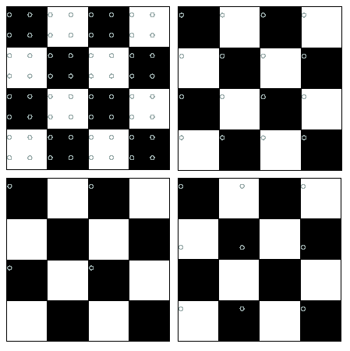
Nyquist limit – 2D example
Good sampling
Bad sampling

Slide 13
Aliasing
When downsampling by a factor of two
Original image has frequencies that are too high
How can we fix this?

Slide 14



Gaussian pre-filtering
G 1/8
G 1/4
Gaussian 1/2
Solution: filter the image, then subsample
Source: S. Seitz

Slide 15
Subsampling with Gaussian pre-filtering
Gaussian 1/2
G 1/4
G 1/8
Solution: filter the image, then subsample
Source: S. Seitz

Slide 16
Compare with...
1/2
1/4 (2x zoom)
1/8 (4x zoom)
Source: S. Seitz

Slide 17
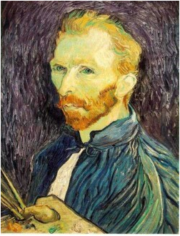






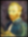
Gaussian pre-filtering
Solution: filter the image, then subsample
F₀
F₁
F₂
…
blur
subsample
blur
subsample
F₀ H
F₁ H
*
*

Slide 18
{
Gaussian pyramid
F₀
F₁
F₂
…
blur
subsample
blur
subsample
F₀ H
F₁ H
*
*

Slide 19
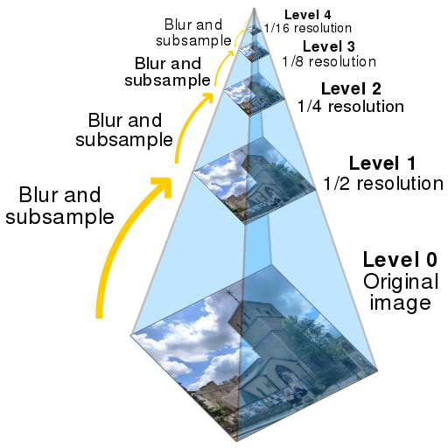
Gaussian pyramids [Burt and Adelson, 1983]

Slide 20
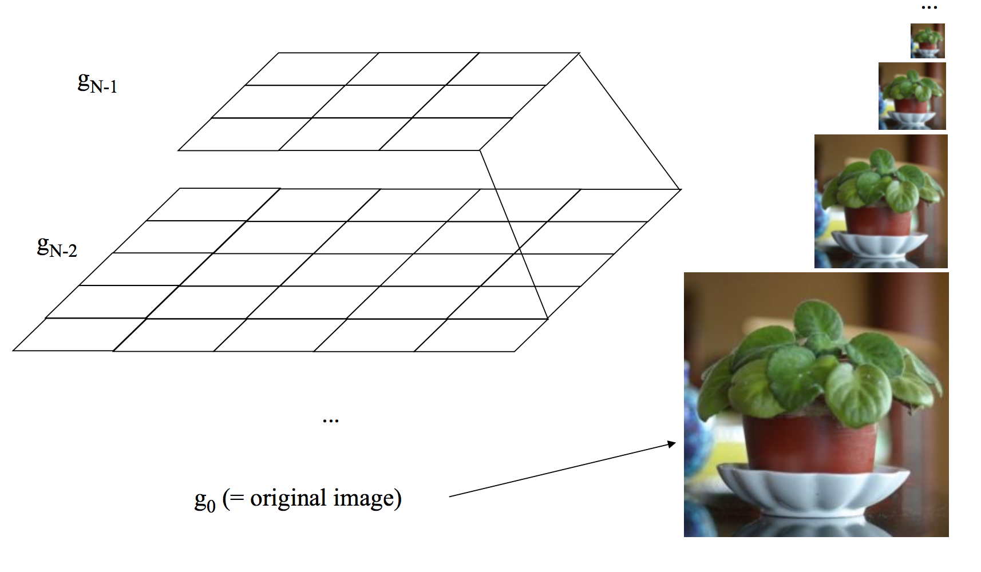
Why is it called a pyramid
Idea: Representation can be pictured as a “pyramid” of 3×3, 5×5, 9×9, …, (2^{n}+1)(2^{n}+1) images.

Slide 21
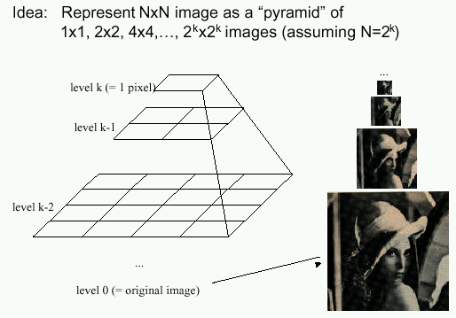
Gaussian pyramids [Burt and Adelson, 1983]
In computer graphics, a mip map [Williams, 1983]
A precursor to wavelet transform
Gaussian Pyramids have all sorts of applications in computer vision
Source: S. Seitz

Slide 22
Gaussian pyramids [Burt and Adelson, 1983]
How much space does a Gaussian pyramid take compared to the original image?
Source: S. Seitz

Slide 23
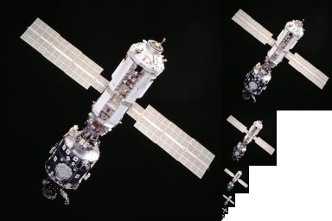
Gaussian Pyramid

Slide 24
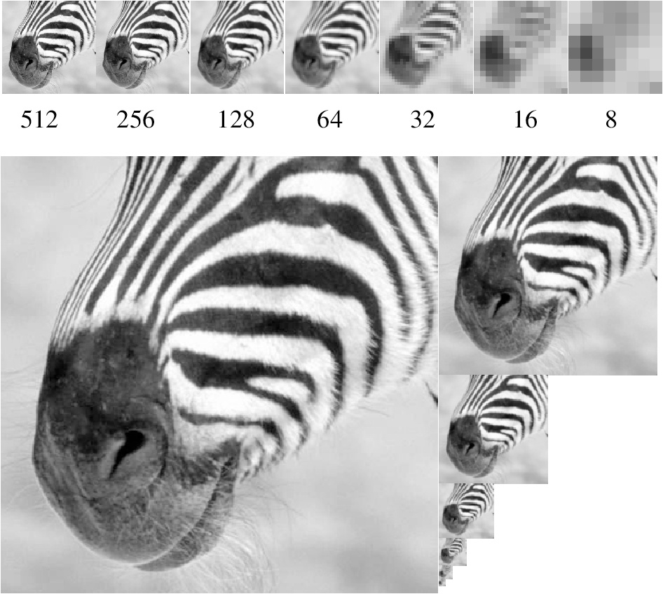
Gaussian pyramid
Source: Forsyth

Slide 25
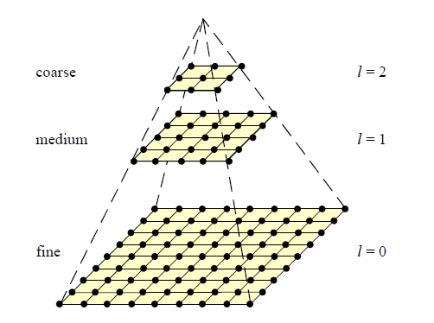
Coarse-to-fine Image Registration
Compute Gaussian pyramid
Align with coarse pyramid
Successively align with finer pyramids
Search smaller range
Why is this faster?
Are we guaranteed to get the same result?

Slide 26
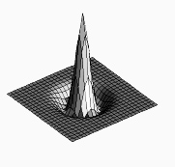

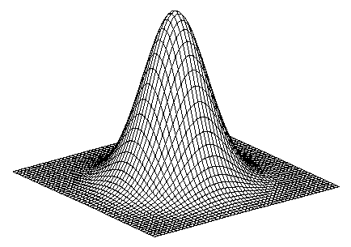
Laplacian filter
unit impulse
Gaussian
Laplacian of Gaussian
Source: Lazebnik

Slide 27
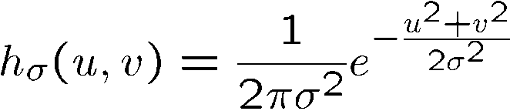
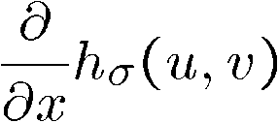
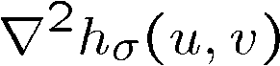
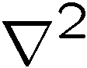
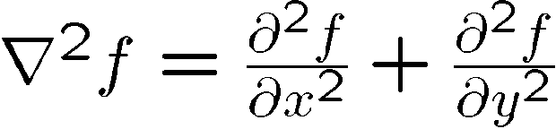
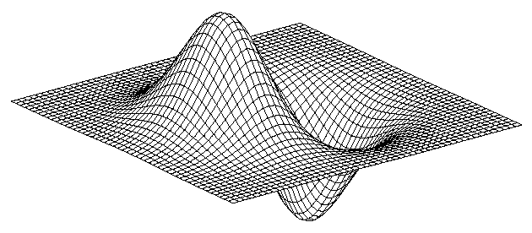
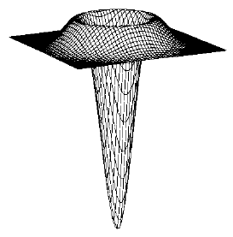
2D edge detection filters
Laplacian of Gaussian
Gaussian
derivative of Gaussian
is the Laplacian operator:
Notes:
How many 2nd derivative filters are there? There are four 2nd partial derivative filters.
In practice, it’s handy to define a single 2nd derivative filter—the Laplacian

Slide 28
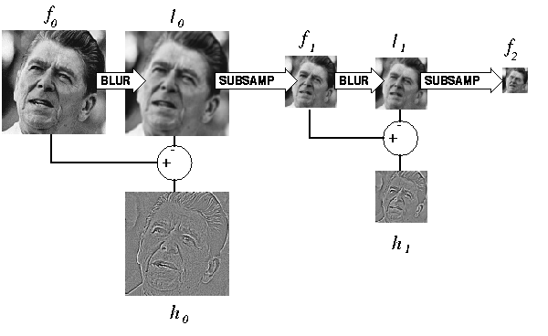
Computing Gaussian/Laplacian Pyramid
Can we reconstruct the original from the laplacian pyramid?
http://sepwww.stanford.edu/~morgan/texturematch/paper_html/node3.html

Slide 29
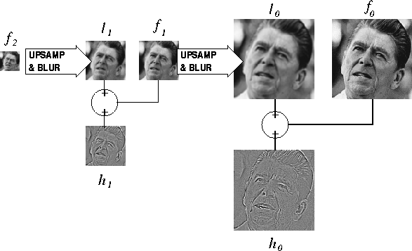
Can we reconstruct the original from the laplacian pyramid?
http://sepwww.stanford.edu/~morgan/texturematch/paper_html/node3.html

Slide 30
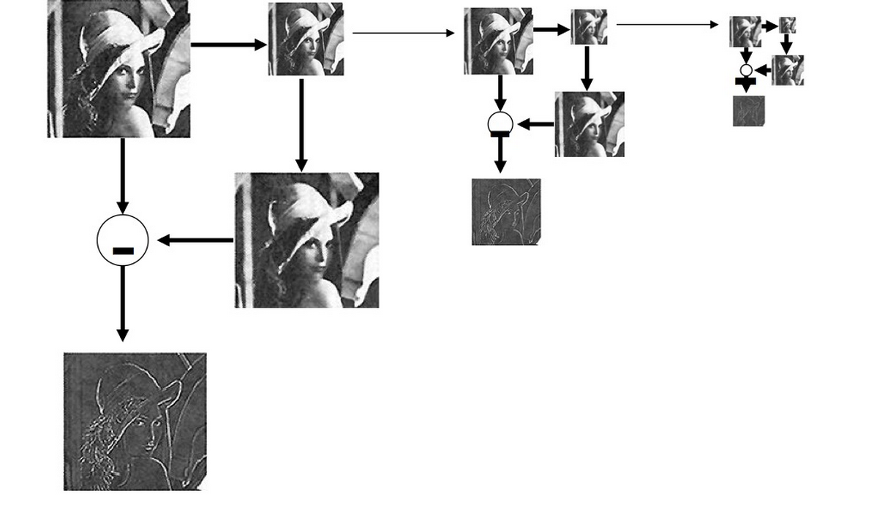
Laplacian Pyramid

Slide 31
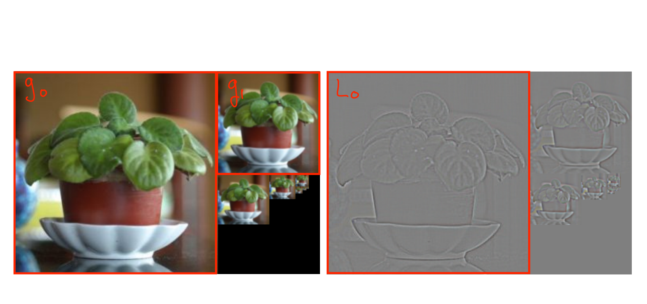
Laplace pyramid
Rather than store the smoothed images, store only the difference between the levels g_{l} and g_{l+1}

Slide 32
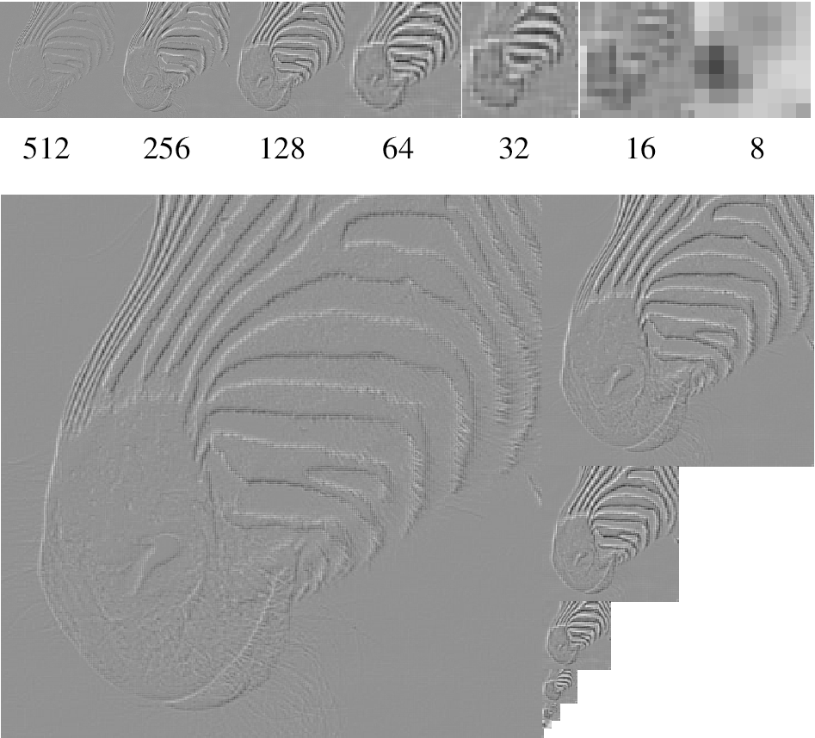
Laplacian pyramid
Source: Forsyth

Slide 33
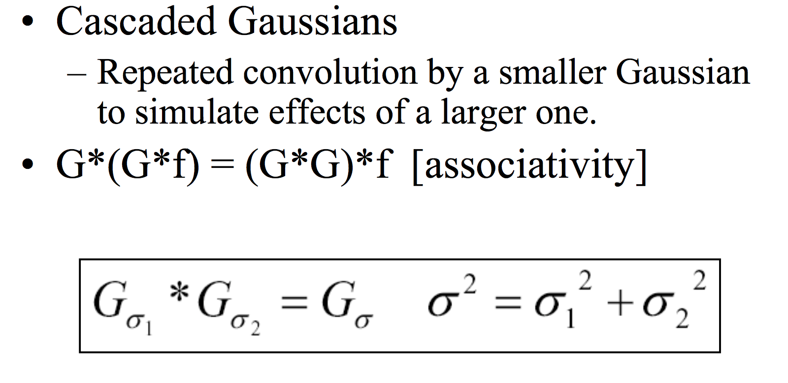
Mathematical Foundation of Pyramids

Slide 34
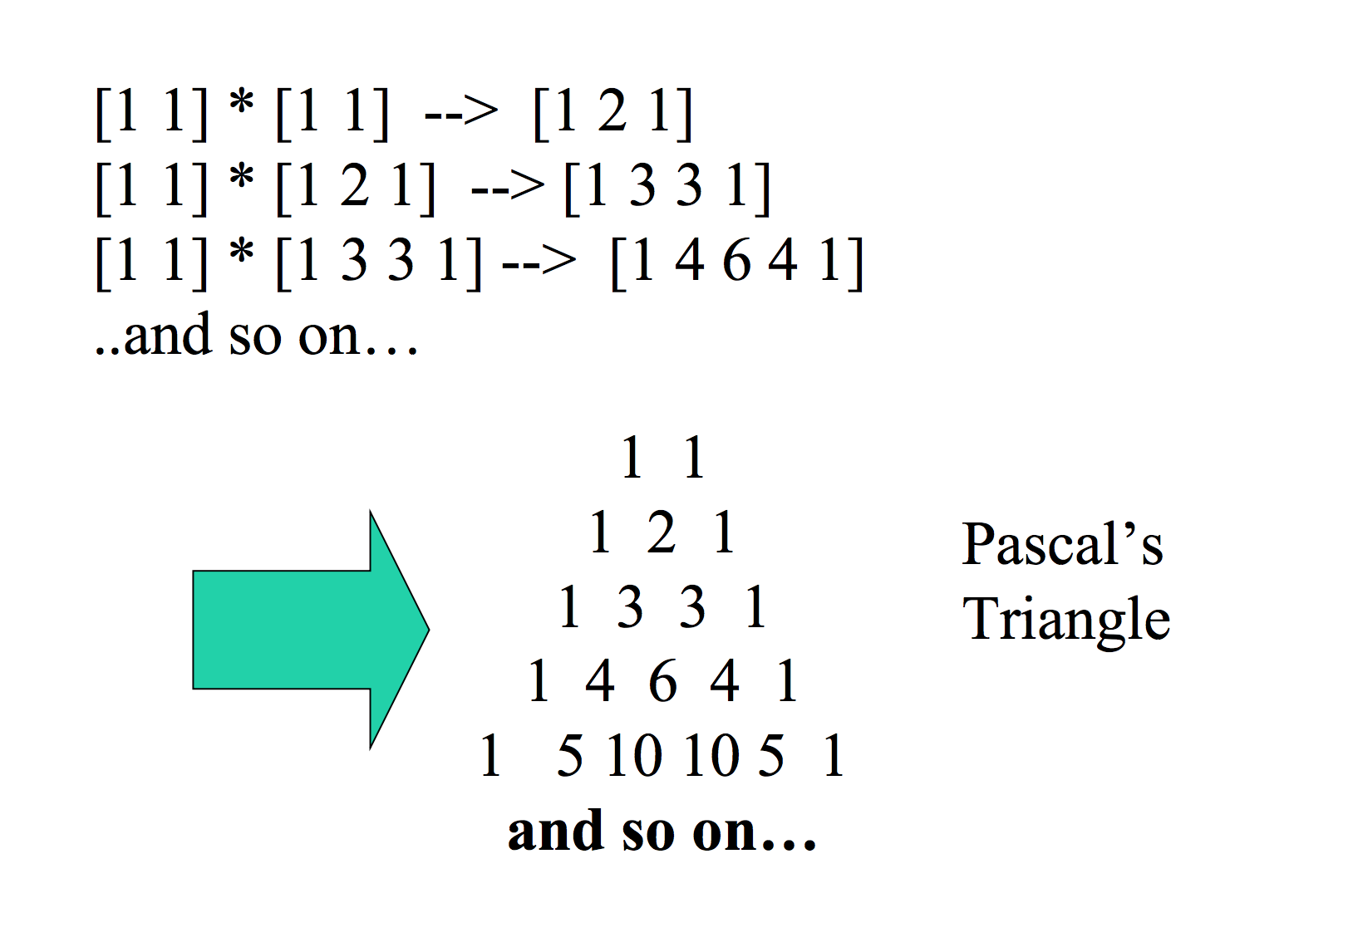
Example: Cascaded Convolutions

Slide 35
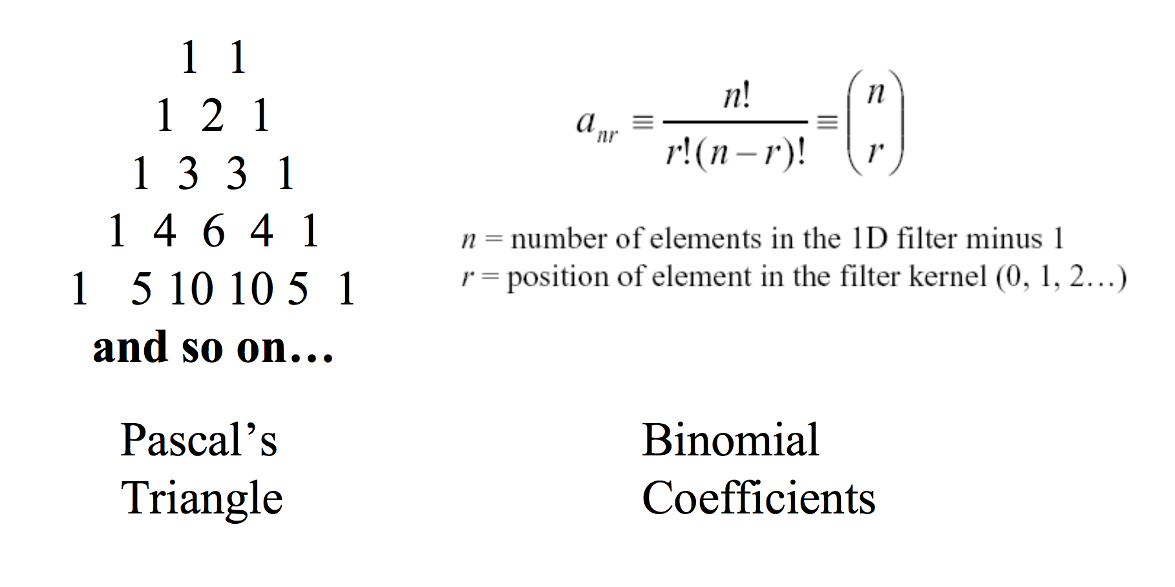
Aside: Binomial Approximation

Slide 36
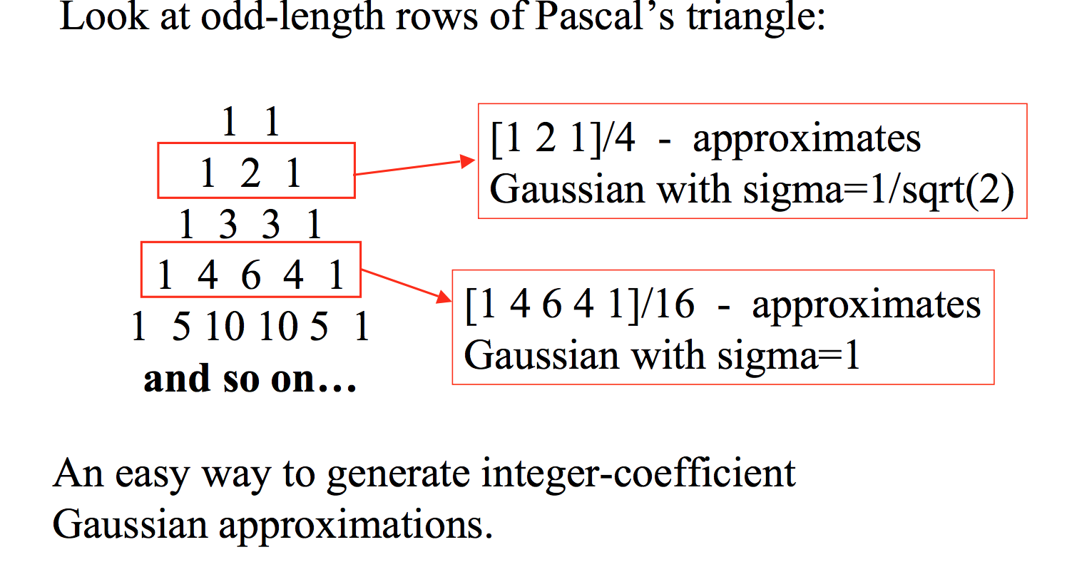
Aside: Binomial Approximation

Slide 37
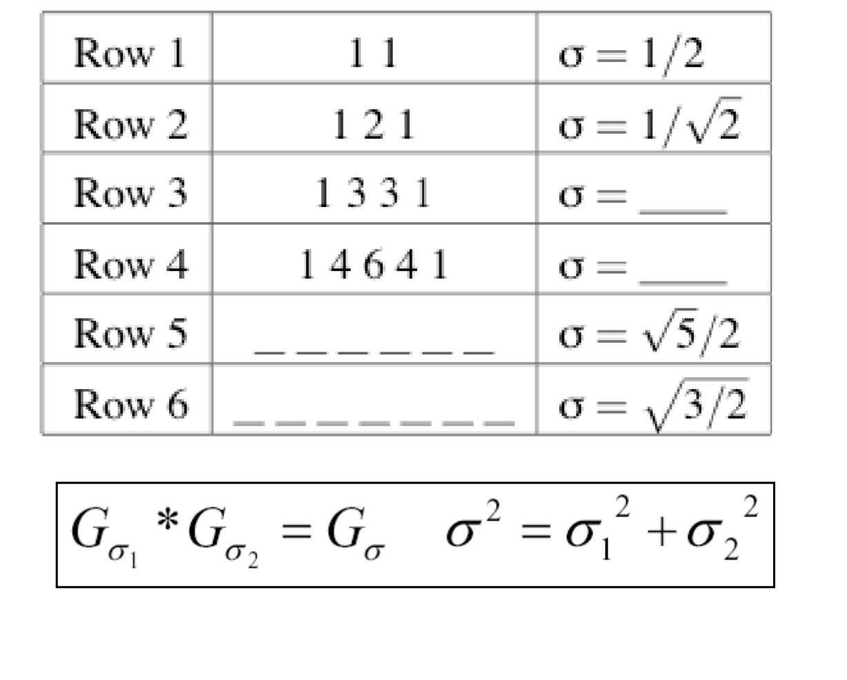
Aside: Binomial Approximation

Slide 38
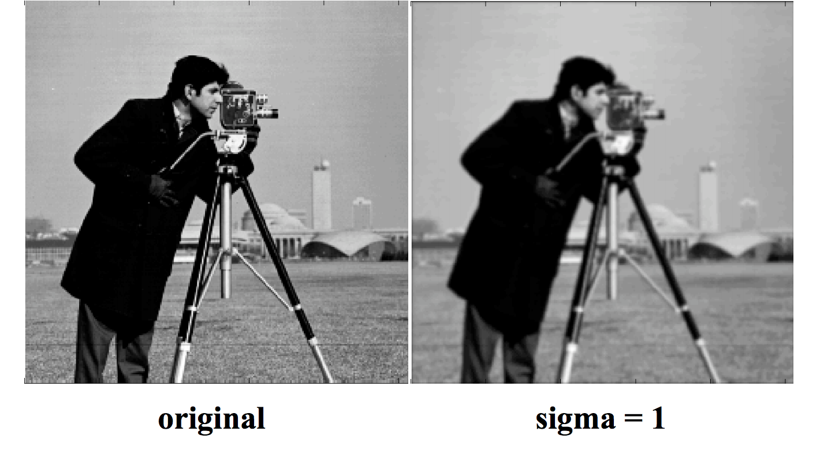
Gaussian Smoothing at Different Scales

Slide 39
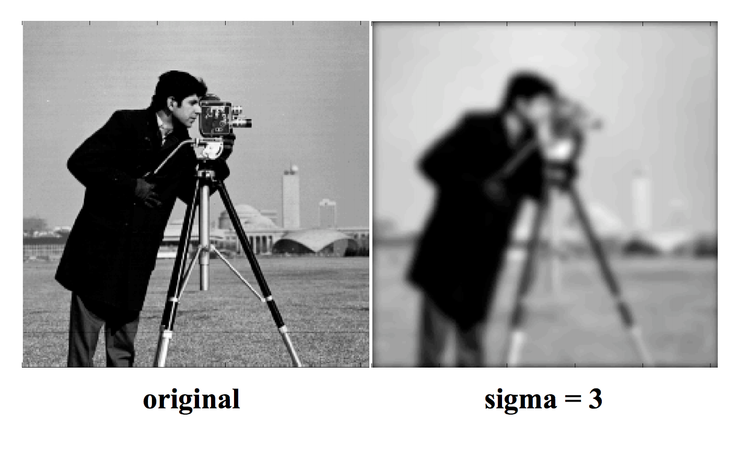
Gaussian Smoothing at Different Scales

Slide 40
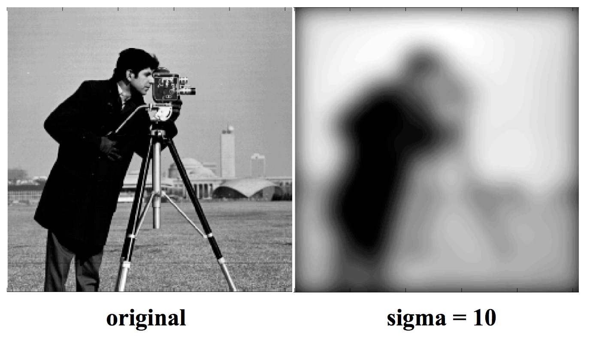
Gaussian Smoothing at Different Scales

Slide 41
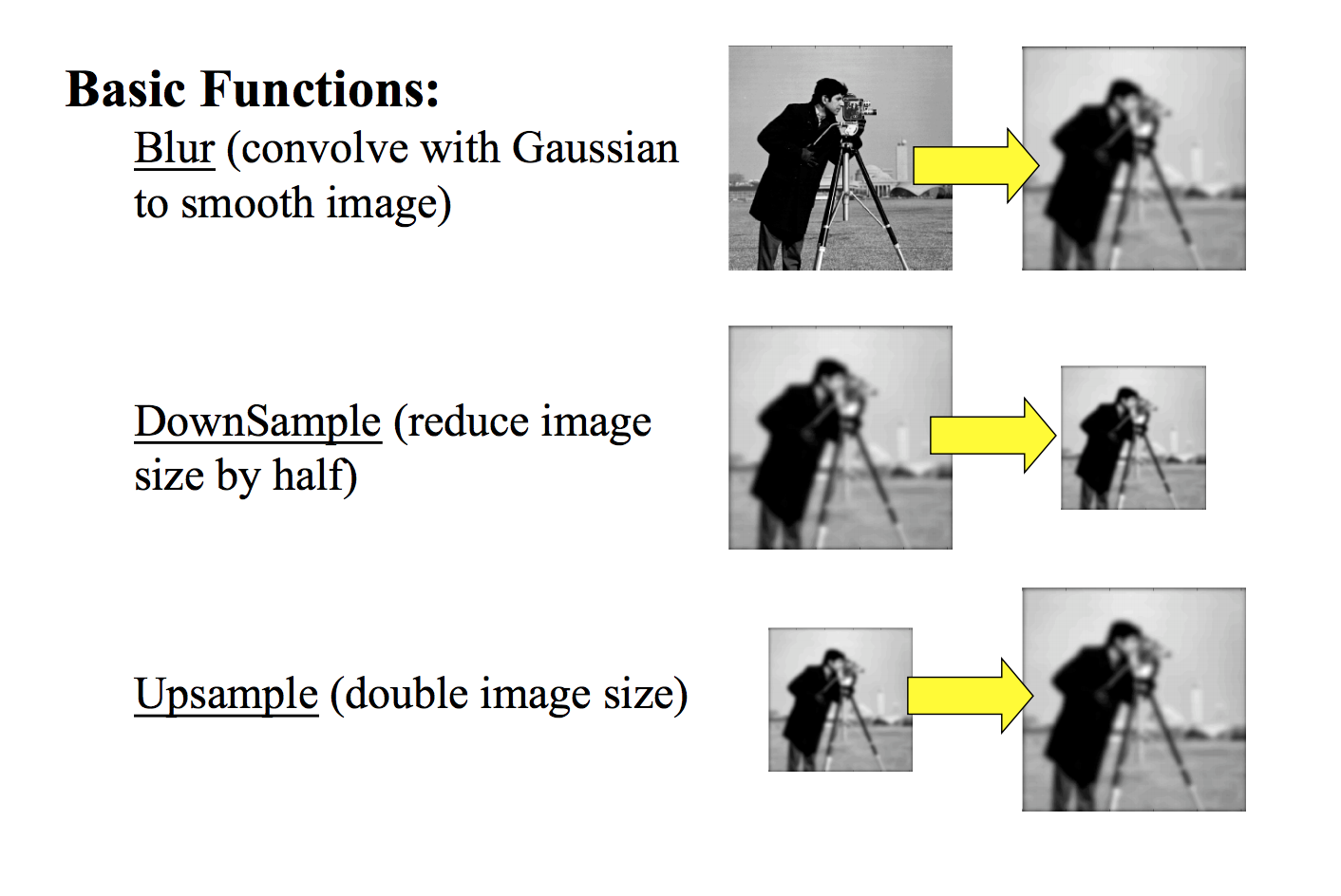
Generating a Gaussian Pyramid

Slide 42
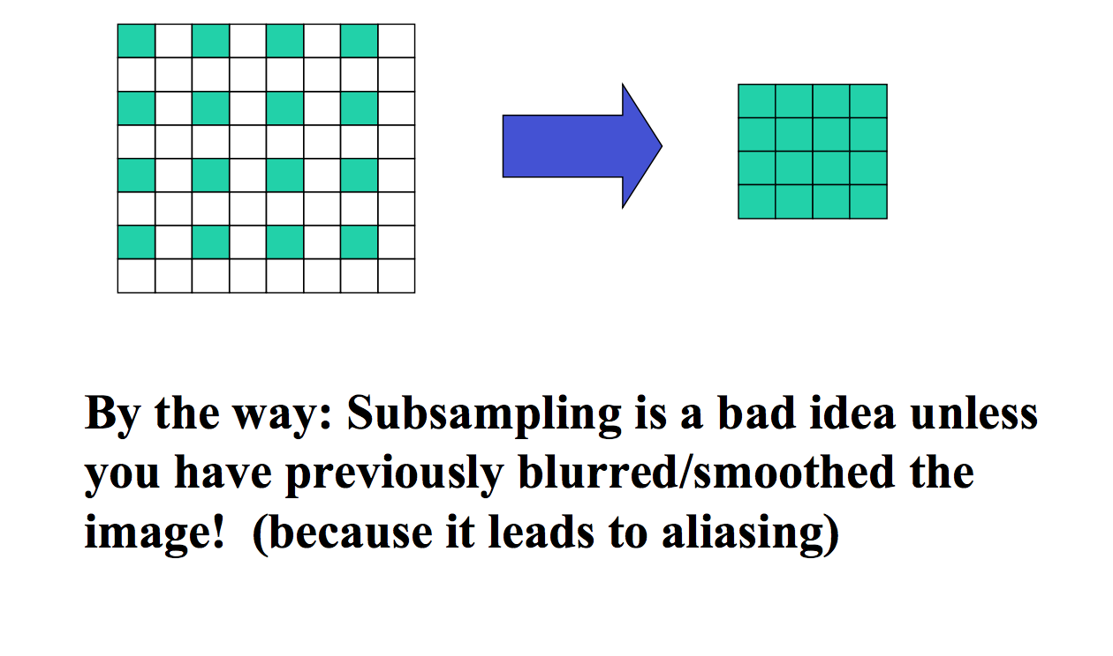
Downsample

Slide 43
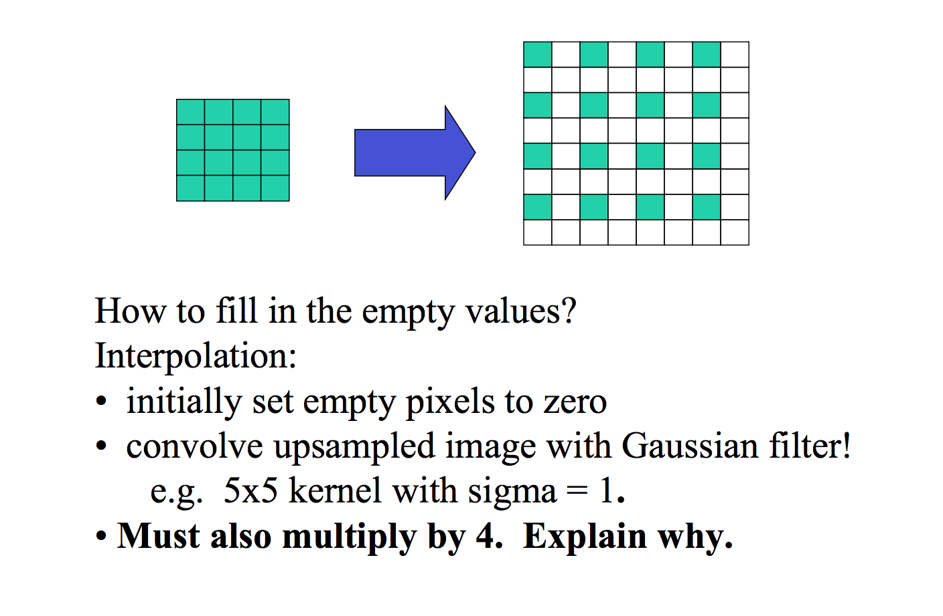
Upsample

Slide 44
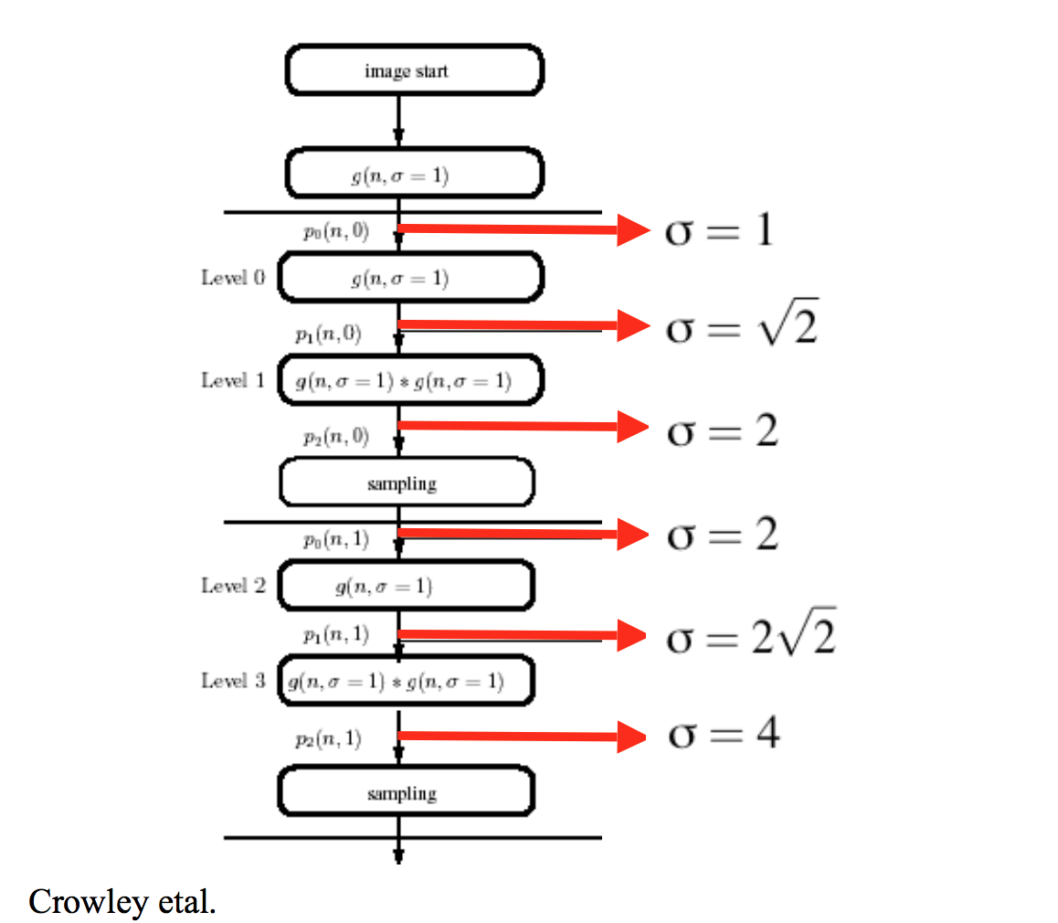
Effective Sigma at Each Level

Slide 45
How to build Pyramid in Python
A Gaussian pyramid is basically a series of increasingly decimated images, traditionally at down sampling rate r=2. At each level, the image is first blurred by convolving with a Gaussian-like filter to prevent aliasingin the downsampled image.
def decimate(image):
"""
Decimates at image with downsampling rate r=2.
"""
# Blur
image_blur = ndimage.filters.convolve(image,kernel, mode='constant')
# Downsample
return image_blur[::2, ::2]

Slide 46
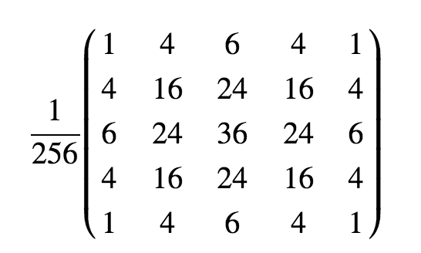
How to build Pyramid in Python
Need a filter:
Binomial filter:
[ 1 4 6 4 1]
5-tap filter :

Slide 47
How to build Pyramid in Python
To build the Laplacian pyramid, we take each level of the Gaussian pyramid and subtract from it the next level interpolated to the same size.
def interpolate(image):
"""
Interpolates an image with upsampling rate r=2.
"""
image_up = np.zeros((2*image.shape[0], 2*image.shape[1]))
# Upsample
image_up[::2, ::2] = image
# Blur (we need to scale this up since the kernel has unit area)
# (The length and width are both doubled, so the area is quadrupled)
return ndimage.filters.convolve(image_up,4*kernel, mode='constant')

Slide 48
How to build Pyramid in Python
G = [image, ]
L = []
# Build the Gaussian pyramid to maximum depth
while image.shape[0] >= 2 and image.shape[1] >= 2:
image = decimate(image)
G.append(image)
# Build the Laplacian pyramid
for i in range(len(G) - 1):
L.append(G[i] - interpolate(G[i + 1]))
return G[:-1], L

Slide 49
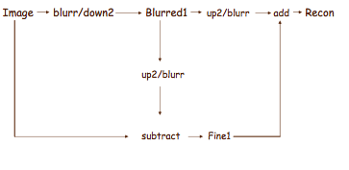
How to build Pyramid in Python

Slide 50
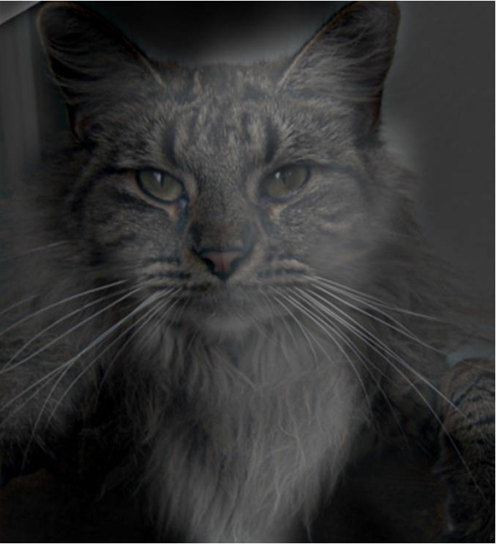
Hybrid Image

Slide 51
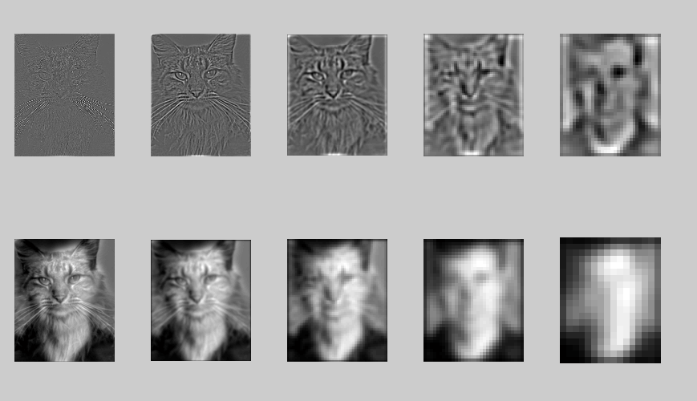
Hybrid Image in Laplacian Pyramid
High frequency → Low frequency

Slide 52
Major uses of image pyramids
Compression
Object detection
Scale search
Features
Detecting stable interest points
Registration
Course-to-fine

Slide 53
Take-home reading
Original paper of Image Pyramids:
http://persci.mit.edu/pub_pdfs/pyramid83.pdf
Chapter 3.5 Szeliski
Create a GitHub account and commit your homework code

